Slide 1
Git Branch Development for AnDLA
Weijun Chen
2024/09/12

Slide 2
Agenda
“Git branch" usage
Local repository co-working
Guideline and principle for andla_i350 git branch development
Discussion of regression test on "develop/master" branch

Slide 3
Git Branch – Basic
branch: a pointer to a commit
On a branch, create commit will literally “branch” from others
To point to another existing commit, use git reset --hard
(currently on master)
% git branch feature1
master
feature1
(do some changes on master)
% git commit –am “blabla”
master
% git checkout feature1
(do some changes)
% git commit –am “blabla2”
master
feature1
feature1
(currently on manu1)
% git reset --hard HEAD~1
% git reset --hard feature1
master
master
master
manu1
feature1
feature1
feature1
manu1
manu1

Slide 4
Git - Concepts
From reference log and reset operation, we know…
All the footprints of the “HEAD”(or even branches) will be preserved.
(Of course, if you delete the .git/, it will be gone right there)
All the proper git operations just keep “adding footprints” in reference log
Git log only shows the commits which are existing branches’ ancestors
You can’t see the commit that was reset previously, since it is no longer a part of any branch’s ancestor
Commits that are not ancestor of any branch are just ignored but not eliminated
Never try to modify the “history”(aka footprint) because you can’t.
If something goes wrongly, there are some solutions:
Add “revert commits”
Reset the wrong commit and just lead the branch to the correct commit
HEAD
At default, the commits in reflog have lifetime of 90 days.
gc.reflogExpire in .gitconfig
Unreachable commits in reflog have lifetime of 30 days.
gc.reflogExpireUnreachable in .gitconfig
Find them in reflog if you want

Slide 5
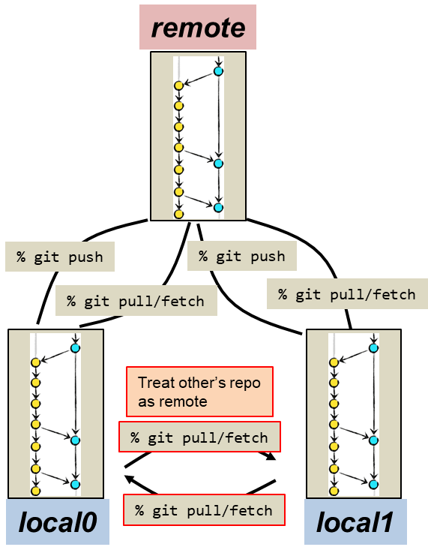
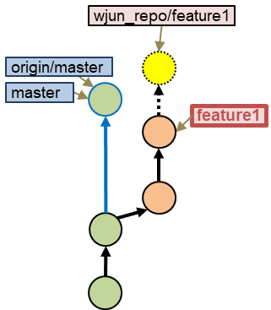
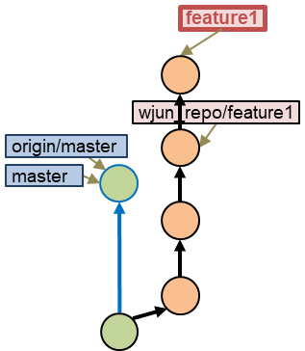
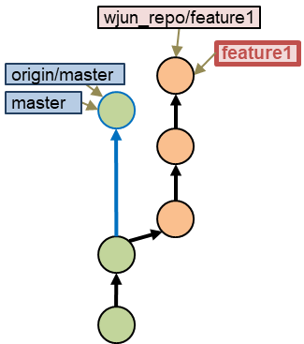
Git Remote Control & Local Repo co-work
Collaborative Development – developed with multiple developers
Each developer owns a local repository.
All developers’ local repositories synchronize with a remote repository
Even other’s local repo can be the remote
Local repo coworking
(currently on feature1)
% git fetch wjun_repo
% git branch –u wjun_repo/feature1
(on other’s repo, do the same steps)
(currently on feature1)
% git commit –am “ccc”
(currently on feature1)
% git pull

Slide 6
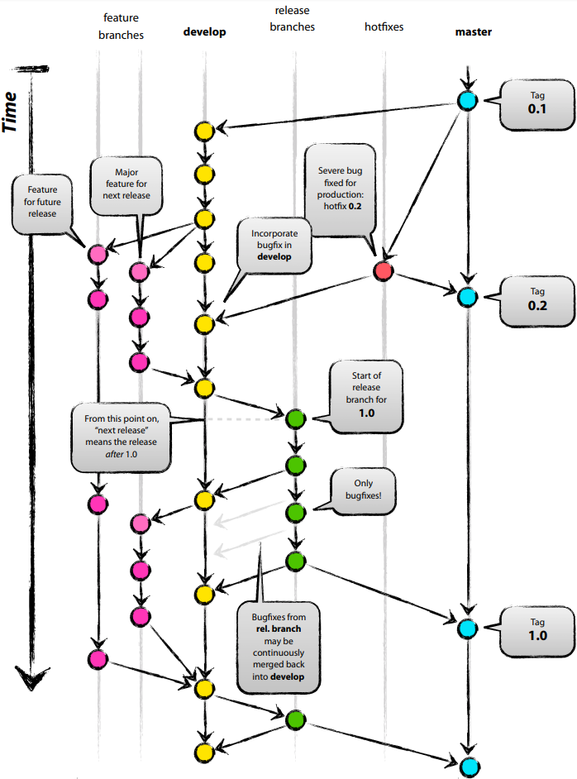
Git Branching Development
Reference:
http://nvie.com/posts/a-successful-git-branching-model/

Slide 7
Guideline and Principle for AnDLA Project
Do
隨時隨地自由且”盡量”commit，將commit視為ctrl+s，維持working tree clean
隨時隨地使用feature branch開發
移動branch多利用git reset --hard
多利用local repository coworking
Always pull --rebase
Or set (.gitconfig) pull.rebase=true
Don’t
保持長時間uncommit changes
建議下班前commit 所有 changes on自己的branch，防止改動遺失
commit unnecessary “data pattern” or “log file”
使用名稱區別版號
push feature branch
push main branch w/o check

Slide 8
Guideline and Principle for AnDLA Project
Principle
Push develop前需要Pass ST Test (need discussion)
Push master前必須提前mail告知所有人，且Jason同意後才能push
master commit必須從develop or release branch merge而來
只有develop/master 需要使用到push，feature branch請使用local repo coworking
merge回develop時，必須成半月形，parent1 線上必須無其他commit
pull --rebase後再merge non-fast-forward
develop
feature1
Not allow commit on this line

